Slide 1

Building & Electric Vehicle Reach Codes
CALBIG – ICC Local Chapter #1934
Advancing safer, healthier and more affordable buildings
January 8, 2020

Slide 2
Agenda
What are reach codes – and, why?
Reach code basics
Building reach code details
Electric vehicle code details
Commonly cited concerns
Implementation plan
Summary
Questions and Discussion

Slide 3

What is Peninsula Clean Energy?
Peninsula Clean Energy is the official electricity provider for San Mateo County
providing cleaner power at lower rates
Notes:
Reduce climate pollution
Foster economic development
Savings of more than $18 million/year for accounts across San Mateo County

Slide 4
What are Reach Codes?
Councils adopt new building codes this year as part of the State’s 3-year building code cycle
Reach codes are local enhancements to state code
Adopting with code cycle is efficient for staff and builders
PCE initiative aimed at improved economic and energy performance for new construction
Addresses:
  Building electrification – reduced use of natural gas
  Electric vehicle (EV) charging – increased EV readiness

Slide 5
Summary of Benefits
Major economic value for residents
Safer and healthier homes
Advance climate goals
Enable much greater EV adoption
Fiscal prudence – more cost effective to address at new construction
This Reach Code effort applies only to NEW construction
Over $50M/yr
San Mateo Co “fuel” savings by reaching 45,000 EVs in 2025
1-2 tons CO2
avoided per year for every home
Notes:
Reduced fueling costs for residents
By 2025 approximately 45,000 EVs in SM Co
EV savings over gas car $1,200+/year
Reduced Construction expenses
25,000 new housing units
EV Reach Code <$1.5k/unit at new construction
$7k/unit for retrofit

Slide 6
Reach Code Basics
Reach Code Type |  | How it Works
Building | Natural Gas Ban* | No gas hookup allowed (via municipal ordinance)
 | All-Electric Required* | Appliances must be electric (via Energy Code, Title 24 Part 6)
 | All-Electric Preferred | Allows mixed-fuel buildings with high energy performance: additional energy efficiency measures battery storage electric-ready (pre-wiring)
Electric Vehicle* |  | Increases EV infrastructure (via CALGreen, Title 24 Part 11)
* Exceptions where necessary

Slide 7

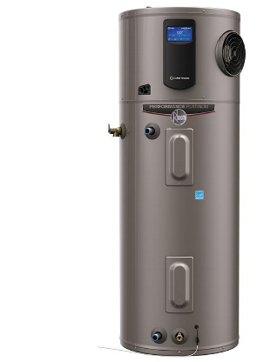

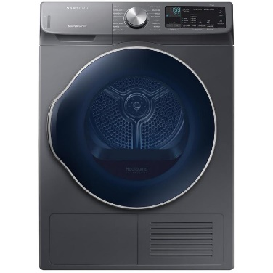
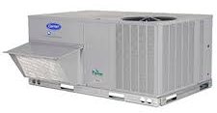
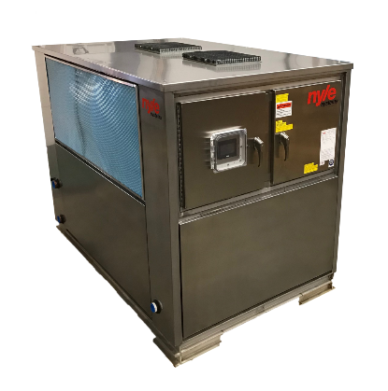
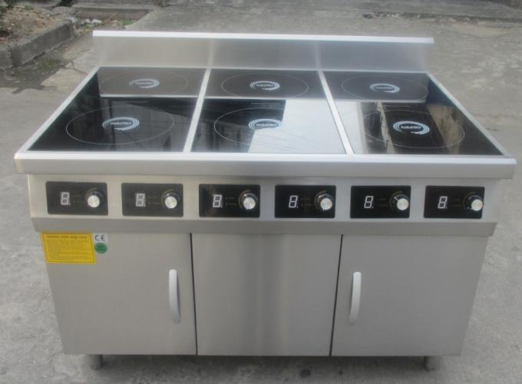

Building Electrification Measures
Space Heating
Water Heating
Cooking
Clothes Drying
Residential
Commercial

Slide 8
Equipment Efficiency

Slide 9
Building All-Electric New Construction Costs Less Than With Gas
All-electric homes are less expensive to build
Natural gas plumbing, metering and venting is not required
Multiple independent analysis including Statewide IOUs and University of California
University of California commits to all-electric construction for all new buildings
Notes:
UC Carbon Neutral Buildings Cost Study. June 23, 2017
https://www.ucop.edu/sustainability/_files/Carbon%20Neutral%20New%20Building%20Cost%20Study%20FinalReport.pdf
UC commitment to all-electric
https://policy.ucop.edu/doc/3100155/SustainablePractices

Slide 10
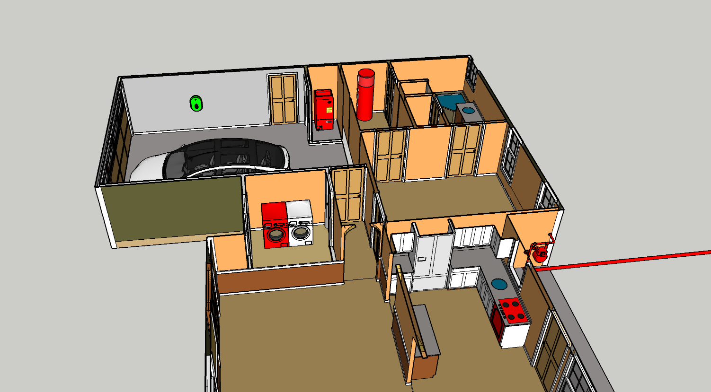
Electrifying New Single Family Homes in the Bay Area – The Cost Story
Electrifying New Single Family Homes in the Bay Area – The Cost Story
Water Heater
Construction: $510 ↓
Monthly: $7/mo ↑
Water Heater
Construction: $510 ↓
Monthly: $7/mo ↑
Summary
Summary
All-Electric Home
Construction: $10,580 ↓
Monthly: $7/mo ↑
All-Electric Home
Construction: $10,580 ↓
Monthly: $7/mo ↑
Electric Vehicle Charger
Construction: Same cost, including incentives
On-going: $138/mo ↓
Electric Vehicle Charger
Construction: Same cost, including incentives
Monthly: $138/mo ↓
Summary
All-Electric Home, Increased Solar
Construction: Equal
Monthly: $5/mo ↓
All-Electric Home
Construction: $10,580 ↓
Monthly: $7/mo ↑
All-Electric Home, Increased Solar
Construction: Equivalent
Monthly: $5/mo ↓
Space Heater
Construction: $2000 ↓, assuming air-conditioning also installed
Monthly: $10/mo ↓
Space Heater
Construction: $2000 ↓, assuming air-conditioning also installed
Monthly: $10/mo ↓
All-Electric Home, Increased Solar
Construction: Equivalent
Monthly: $5/mo ↓
Gas Meter & Service Not Needed
Construction: $6,000 ↓
Monthly: $7/mo ↓
Indoor Gas Piping Not Needed
Construction: $2,450 ↓
Gas Meter & Service Not Needed
Construction: $6,000 ↓
Monthly: $7/mo ↓
Indoor Gas Piping Not Needed
Construction: $2,450 ↓
Cooktop
Construction: $380 ↑
Monthly: $6/mo ↑
Clothes Dryer
Construction: equal
Monthly: $11/mo ↑
Cooktop
Construction: $380 ↑
Monthly: $6/mo ↑
Clothes Dryer
Construction: equivalent
Monthly: $11/mo ↑
3 MT CO2e Carbon Emissions Savings per home, per year based on 2030 grid mix
$191 Net Lifecycle Cost Savings per year for an all-electric home versus the mixed-fuel equivalent
3 MT CO2e Carbon Emissions Savings per home, per year based on 2030 grid mix
$191 Net Lifecycle Cost Savings per year for an all-electric home versus the mixed-fuel equivalent
Construction and Monthly costs of thermal systems are based on Residential Building Electrification in California by E3 (April 2019); electricity costs specific to PCE/SVCE territory
All-Electric Home, Increased Solar bill impacts are based on Low-Rise Residential New Construction 2019 Cost Effectiveness Study by Frontier Monthly (August 2019)
Version 7 10/14/2019
Notes:
3bdr/2ba, 2200 sq ft
Residential Building Electrification in California
Consumer economics, greenhouse gases and grid impacts
April 2019
E3
https://www.ethree.com/wp-content/uploads/2019/04/E3_Residential_Building_Electrification_in_California_April_2019.pdf

Slide 11
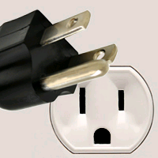

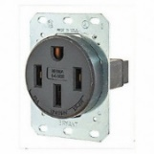

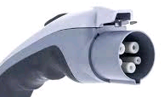

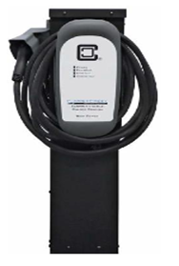
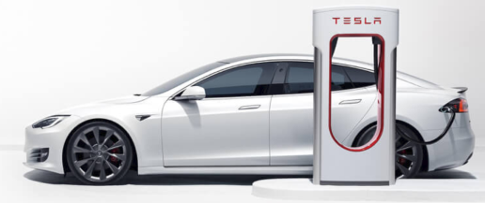
Electric Vehicle Code Options
Speed
Readiness
Number
EV Capable
Level 1
“Trickle Charging”
Percent of Parking Spaces
Level 2
“Standard Charging”
EV Ready
Level 3
“DC Fast / SuperCharging”
EV Charging Station
11

Slide 12
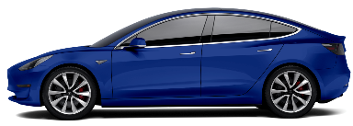
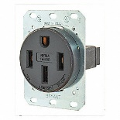


Electric Vehicles - Single and Two-family New Construction
 | 2016 CALGreen | 2019 CALGreen | PCE/SVCE Proposed
 | Mandatory | Mandatory
Single Family Two-Family Townhome | (1) Level 2 EV Capable for one parking space per dwelling unit |  | 2 EV spaces total: 1 Level 2 EV Ready circuit 1 Level 1 EV Ready circuit
ELECTRIC
VEHICLE
OUTLET

Slide 13
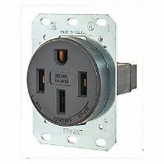
Electric Vehicles - Multifamily New Construction
ELECTRIC
VEHICLE
OUTLET
 | 2016 CALGreen | 2019 CALGreen | PCE/SVCE Proposed
 | Mandatory | Mandatory
Multi-Family
3%
10%
25%
100%
75%
≤20
dwelling units
>20
dwelling units
3% Level 2 EV Capable for buildings with ≥17 units
10% Level 2 EV Capable
≤20 units: One Level 2 EV Ready per dwelling
>20 units: Of all dwelling units,
25% Level 2 EV Ready (10% in affordable housing)
75% are Level 1 EV Ready (90% in affordable housing)
Allow load-sharing

Slide 14
Electric Vehicles - Non-Residential, Office & Commercial
ELECTRIC
VEHICLE
OUTLET
 | 2016 CALGreen | 2019 CALGreen | PCE/SVCE Proposed
 | Mandatory | Mandatory
Non-Residential
Commercial: Of all parking spaces,
6% Level 2 EVSE
5% Level 1 EV Ready
Office building:
10% Level 2 EVSE
10% Level 1 EV Ready
30% EV Capable or EV Ready
∼6% Level 2 EV Capable
(for buildings with at least 10 parking spaces)
Over 100 spaces: option for 80kW DC Fast Charger per 100 spaces

Slide 15
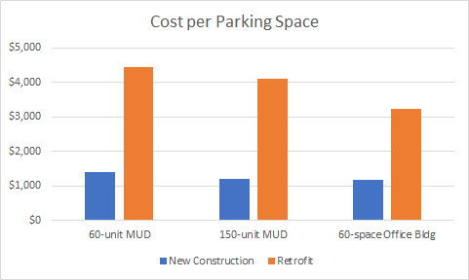
EV Cost of New vs. Retrofit
Represent costs compared to CALGreen Mandatory for 25% Level 2 and 75% Level 1
PG&E 'cost-per-port' is $18,000 for retrofits
Costs include wiring, switch gear, conduit, trenching, and secondary transformer
Electric Vehicle Infrastructure Cost Analysis Report for PCE and SVCE
Pacific Gas and Electric Company EV Charge Network Quarterly Report, Q1 2019

Slide 16
Commonly Cited Concerns (1 of 2)
Concern | Response
Distribution grid upgrades are expensive | Sometimes true. Costs may be offset from the savings of all-electric construction.
Resilience, power-shutoffs | Real problem, but gas does not help. Gas appliance ignition is electric. State policy for grid hardening is key.
Uniformity of requirements | Fair concern, but all-electric is simpler & not adopting ensures future risk. PCE and regional partners are encouraging consistency. All-electric is simple and inaction locks in future cost (retrofits, rates) and risk (fire).
Central heat pump water heating requires more design expertise and space than gas boilers. | True, training needed. There are scores of working systems, but best practice is still under development. We recommend exempting projects with significant space concerns (i.e., entitled projects).

Slide 17
Commonly Cited Concerns (2 of 2)
Concern | Response
Electric heating uses too much energy | False. Electric heat pumps are highly efficient and effective in weather far colder than ours. DOE studies show heat pump space heaters as highly efficient at as little as 5 degrees Fahrenheit.
Energy is not clean | False. PCE base service is 80% GHG free today and targets 100% renewable “round the clock” by 2025
Equipment is not available | Mostly false. Some scenarios for high-volume or steam applications are more challenging to address with electric heating. Heat pumps and induction stoves have a long-established history but market awareness needs to grow. PCE will address training needs.
Notes:
Heat pumps use too much energy or can’t work in our cool climate:
Heat pumps are highly effective in weather far colder than ours. DOE’s National Renewable Energy Lab, in an authoritative 2017 study (link, p.42), cites heat pump space heaters with operating effectiveness at 5 degrees Fahrenheit with a “coefficient of performance” of 3 – which is to say it generates 3x the heat for unit of energy input (heat pumps are essentially refrigerators or AC units in reverse). This is consistent with the California Energy Commissions cost effectiveness studies.

Slide 18
Implementation Coordination
California Energy Commission / Title 24 Part 6
  2019 - Removing barriers to central HPWH and electric space-heating compliance, including modeling improvements and best practices guides
  2022
    Prescriptive path for all-electric high-rise multifamily, including central HPWH
    Emissions-based performance metrics
Regional Coordination
  Coordinating with BAYREN, IOUs, EBCE, San Jose, Berkeley, and others to pool resources for implementation materials

Slide 19

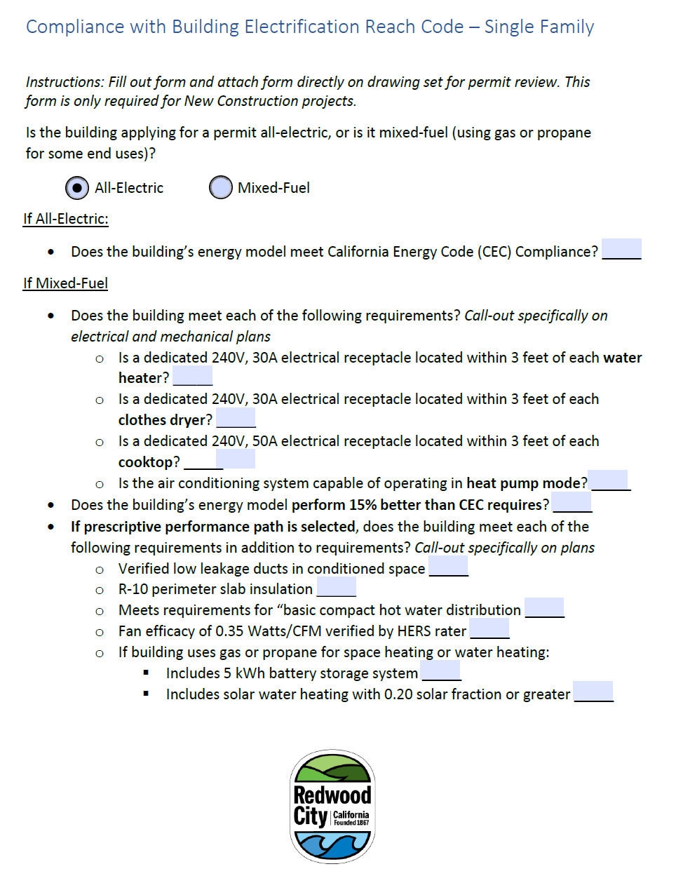
Resources for Implementation
Adoption Resources
Ordinance Language
Staff Report & Slides
Homeowner Flyer
FAQs
Cost Effectiveness Infographic
Permitting, enforcement, and inspection resources
Permit Checklist
Inspection Checklist
Training for Building Department Staff
Counter Materials
FAQs

Slide 20





Resources for Cities
$10,000 grant
Optional model codes
Consultant time for questions, customization
Adoption and implementation tools

Slide 21
What Other Agencies are Doing
Buildings
City | Choice All-Electric or High Efficiency Mixed-Fuel | All-Electric with Limited Gas Usage | Natural Gas Ban | Electric Vehicles
Burlingame |  | Exploring |  | EV Ready code (PCE model)
Brisbane |  | ADOPTED |  | Aggressive EV Ready code
Menlo Park |  | ADOPTED |  | Increase chargers & EV Capable (2018)
Milpitas | ADOPTED |  |  | Increase chargers & EV Capable
Morgan Hill |  |  | ADOPTED
Mountain View |  | ADOPTED |  | Aggressive EV Ready code
Pacifica |  | ADOPTED |  | Increase chargers (2017)
Palo Alto |  | ADOPTED |  | Aggressive EV Ready code
Redwood City |  | COUNCIL OK |  | EV Ready code (PCE model)
San Mateo | ADOPTED |  |  | Increase chargers & EV Capable
San Jose |  | ADOPTED | ADOPTED (low rise) | Increase chargers & EV Capable
County of San Mateo |  | BOARD OK | Proposed | EV Ready code (PCE model)
Over 30 municipalities in San Mateo and Santa Clara counties have adopted or
are currently exploring reach codes
Notes:
Adopted
Berkeley​
Windsor
​​County of Marin
Davis
San Luis Obispo
Santa Monica
Forthcoming
Santa Rosa
Palo Alto
Healdsburg
(partial list – over 50 cities considering across the state)

Slide 22
Contact
Website: www.PeninsulaReachCodes.org
Contact: Rafael Reyes
  Director of Energy Programs
  rreyes@peninsulacleanenergy.com
  (650) 260-0087
  Farhad Farahmand
  Senior Project Manager
  TRC Companies
  ffarahmand@trccompanies.com
  (510) 473-8421

Slide 23
Thank you!

Slide 24
Backup Slides

Slide 25
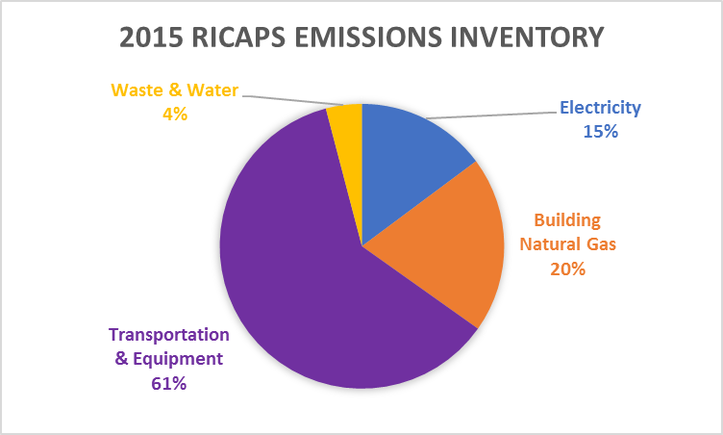
San Mateo County Emissions
Current “Back of Envelope” Calculation
7%
Upstream fugitive emissions are not accounted for so NG impact is likely significantly higher.
Air travel and embedded carbon of products not included

Slide 26


Fire & Health
Ignition Source: Natural gas is a significant fire ignition source
  Pipeline fires: San Bruno, San Francisco
  Half of earthquake fires
Safer Equipment: Induction ranges automatically turn off, eliminating a leading cause of house fires
Faster Recovery: Electrical distribution recovery is repaired faster than natural gas
Health: Gas stoves in homes increase children’s asthma risk by 42%
Notes:
https://ia.cpuc.ca.gov/firemap/
https://www.mercurynews.com/2018/09/02/californians-brace-for-fire/
https://heetma.org/gas-cooking-and-asthma/
*Children living in a home with a gas cooking stove have a 42% increased
risk of current asthma (95% confidence interval [CI] 1.23, 1.64), and a 24%
increased lifetime risk of asthma (95% CI 1.04, 1.47)*
https://www.sciencedaily.com/releases/2008/10/081013131530.htm
Date:
October 14, 2008
Source:
Johns Hopkins Medicine
Summary:
Scientists report that high levels of a noxious gas from stoves can be added to the list of indoor pollutants that aggravate asthma symptoms of inner-city children, especially preschoolers.

Slide 27
Stoves: Consumer Reports Prefers Induction
Top 9 Ranges for 2018 were electric
top 2 were Induction

Slide 28
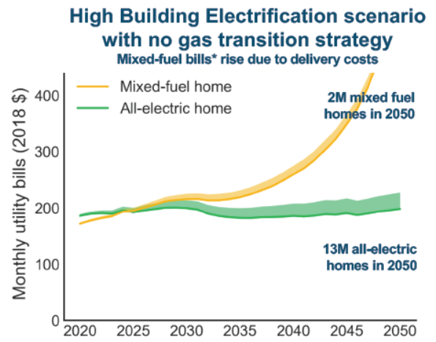
Natural Gas Costs Climbing
CA residential natural gas prices increased 3x faster than electricity prices from 2012 to 2018
Trend expected to accelerate:
Source: EIA
https://www.eia.gov/dnav/ng/hist/n3010ca3m.htm
https://www.eia.gov/electricity/data/browser/#/topic/7?agg=2,0,1&geo=g&freq=M
CEC Workshop June 6, 2019: Draft Results from E3 study on the Future of Natural Gas Distribution in California

Slide 29
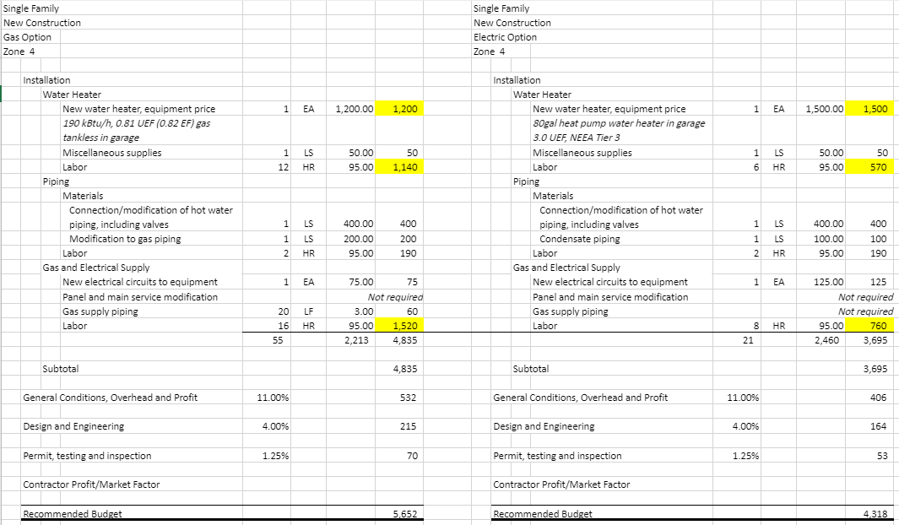
Example Cost Breakdown - WH
Adoption Resources
Ordinance Language
Staff Report & Slides
Homeowner Flyer
FAQs
Cost Effectiveness Infographic
Permitting, enforcement, and inspection resources
Permit Checklist
Inspection Checklist
Training for Building Department Staff
FAQs

